Slide 1
Ex Post Evaluation of the Regional S3s 2014-2020 in Greece:
Methodology, Findings & Recommendations
HELLENIC REPUBLIC
Ministry of Economy and Finance
Dr Yannis Tolias
Innovatia Systems

Slide 2
Scope of the evaluation
Quantify the contribution of the 13 Regional Operational Programmes (ROPs) to the regional S3s and estimate the impacts that can be attributed to the ROP contribution
Thematic focus:
  Thematic Objective 1
  Thematic Objective 2 (investment priorities 2a and 2b)
  Thematic Objective 3, and
  Thematic Objective 8 (investment priorities 8i, 8iii, and 8v)
Data cut-off date: 13.7.2023

Slide 3
Timeline
Inception Report
Finalisation of the evaluation questions and the evaluation plan
Data sources and data requirements
Initial typology of Policy Instruments
Data collection, pilot application in the Region of Western Macedonia
Finalisation of research instruments (surveys, structured interview guides, data analysis tools)
Pilot application of the Evaluation Plan to the Region of Western Macedonia
Document review (13 ROP & 13 S3 texts, 285 call texts related to TO1-2-3-8)
Data collection, cleaning, and fusion from the two main information systems.
Finalisation of the typology of policy instruments after reviewing call texts
Deployment of an online beneficiaries' survey (1 survey per policy instrument comprising common and PI-related questions)
Debates, interviews and supplementary data collection from the remaining 12 ROP Managing Authorities
Apply the approach to 12 Regions
13 Regional Evaluation Reports
13 Policy Instrument fiches
Resuls of the beneficiaries’ survey
Benchmarking of 13 regions using 32 indicators
Answers to the evaluation questions and discussion
Final Report
Validation seminar
Recommendations
28.4.2023
28.6.2023
28.9.2023
7.12.2023
28.12.2023

Slide 4
Methodology
Impact evaluation using contribution analysis, based on the approach implemented for the ex post evaluation of Cohesion policy programmes 2014-2020 financed by the ERDF for RTDI (Prognos, CSIL & Visionary Analytics) and Competitiveness (CSIL & Prognos)
Four levels of analysis:
  The Regional S3 level: the evaluation assessed the S3 action plans (policy mix and budget), but not the relevance of the S3s (see ‘Study on prioritisation in S3s in the EU’ and ‘Analysis of key parameters of S3s’, both by Prognos & CSIL)
  The Programme level: the evaluation assessed the policy mixes implemented by the ROPs to support the respective regional S3s.
  The Policy Instrument level: the evaluation analysed and validated (through the beneficiaries’ survey) the Theories of Change of 16 PIs (12 from the evaluations of Prognos & CSIL above, and 4 new), facilitating the identification of lessons learnt and evidence to support debates and policy considerations
  The project and beneficiary level: In both above analyses, the evaluation examined the profile and particular characteristics of the beneficiaries who implemented the projects considered relevant to the regional smart specialization strategies

Slide 5
Evaluation Questions
Evaluation Issue | Evaluation Questions
Effectiveness | To what extent did the Regional S3s achieve their expected results? To what extent was the Entrepreneurial Discovery Process effective in the Regions? To what extent was the time dimension of support from the ROPs to the Regional S3s implemented as planned? What were the factors that led to any discrepancies? To what extent did the regional S3s achieve the expected outputs? What were the main factors affecting the overall effectiveness?
Efficiency | To what extent was the intensity of funding sufficient to create impact? Were potential synergies or economies of scale exploited with national or European programmes?
Coherence | To what extent did the policy instruments delivered by the ROPs overlap with policy instruments delivered by the national programmes, and in particular the Competitiveness OP? To what extent did the policy instruments delivered by the ROPs overlap with policy instruments by sources beyond the European Structural and Investment Funds?
Relevance | To what extent did the policy instruments delivered by the ROPs address the needs mentioned in the regional S3s? To what extent did the ROP investments through Thematic Objectives 1, 2, 3 and 8 were channeled to projects that supported the regional S3s?
Value-added | To what extent would the objectives of the Regional S3s have been achieved without the support of the ROPs?
Impact | To what extent did the S3-related projects supported by the ROPs lead to the expected outputs and outcomes? To what extent are the S3-related projects supported by the ROPs expected to lead to sustainable impacts? To what extent were the sub-regional S3-related budgetary commitments through the ROPs compatible with the spatial distribution of economic activity?

Slide 6
S3-specific elements of the evaluation
Effectiveness of the EDP
  Degree of adoption of PIs
    EDP → S3 Action Plan
    S3 Action plan → ROP
    ROP text → Calls & projects
  Relevance of the deployed PIs to the stakeholders’ needs
    Number of proposals / number of projects selected for funding
    Budget of proposals / budget of projects selected for funding
    Percentage of the target groups population that submitted a proposal
Funding to S3-related activities
  Share of the ROP budget allocated to S3-related activities
Policy experimentation
  Number of calls and expenditure committed to unique, region-specific S3-related activities, not supported by the national OPs
Degree of overlap in PIs at the regional and the national level
  Share of unique beneficiaries supported by the ROPs per PI
  Share of the contracted expenditure supported by the ROPs per PI
Spatial distribution of S3-related investments at the NUTS3 level normalized by GVA

Slide 7
The Policy Instruments
Active | TOC | Title
✗ | [1] | PI01: Infrastructure investments for Higher Education
✓ | [1] | PI02: Infrastructure investments for Research
✓ | [1] | PI03: Infrastructure investments for Technology Transfer and Innovation
✓ | [1] | PI04: Research activities in Universities or Research Centres
✓ | [1] | PI05: Collaborative RTDI activities
✓ | [1] | PI06: Research activities in businesses
✓ | [1] | PI07: Indirect support for technology transfer
✓ | [1] | PI08: Business investments to support innovation uptake
✗ | [1] | PI09: Capacity building for innovation in businesses
✗ | [2] | PI10: Support for the establishment of new innovative enterprises
✓ | [2] | PI11: Support for the internationalisation of SMEs
✓ | New | PI12: Support for improving the digital maturity of SMEs
✓ | New | PI13: Support for developing human resources for smart specialisation
✓ | [2] | PI14: Business accelerators
✓ | New | PI15: Support for hiring highly-qualified young graduates
✓ | New | PI16: Support for developing regional innovation ecosystems
[1] Prognos, CSIL & Visionary Analytics, «Ex post evaluation of Cohesion policy programmes 2014-2020 financed by the ERDF: WP4-Research, Technological Development and Innovation,» Publications Office of the European Union, Luxembourg, 2023.
[2] CSIL & Prognos, «Ex post evaluation of Cohesion policy programmes 2014-2020 financed by the ERDF: WP6-SME Support,» Publications Office of the European Union, Luxembourg, 2022.

Slide 8
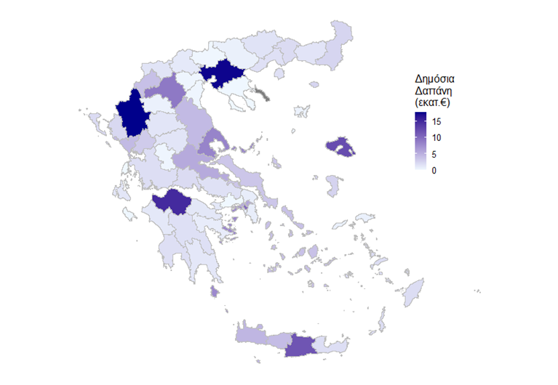
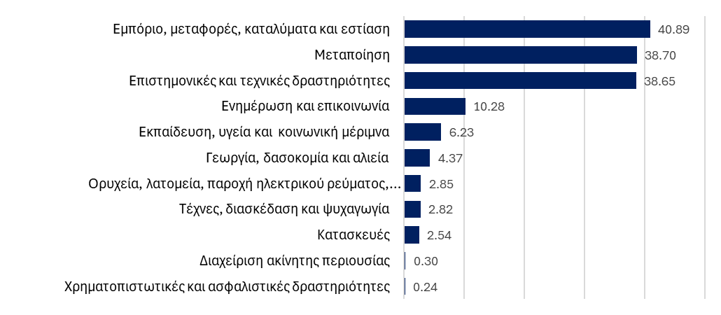
Main quantitative data
Contracted public expenditure through TO1, 2, 3 & 8 by the 13 ROPs until 13.7.2023
The contribution of the 13 ROPs to the respective S3s
3 493
projects
€ 213,03 mil
Contracted public expenditure
Spatial dimension (NUTS3)
€ 2008 mil
Share of the legal commitments of public expenditure for S3-related projects
10,60%
Contracted public expenditure for S3 related projects through TO1, 2, 3 and 8 by the 13 ROPs until 13.7.2023
Trade, transportation/storage, accommodation, food services
Manufacturing
Professional, scientific and technical activities
Information and Communication
Education, Health and social security
Agriculture, Forestry and Fishing
Mining and quarrying, etc excl. manufacturing
Arts and entertainment
Construction
Real estate
Financial and insurance activities
Sectoral dimension
(€ mil)
€ 121.4 mil to enterprises
58%
16%
8%
3%
€ 213 mil
13
Policy
Instruments
Collaborative RTDI projects
Investments in Research Infrastructures
Support for innovation adoption
Digital transformation of enterprises
RTDI projects in enterprises
€ 39 mil.
Very
small
Top-5
€ 36 mil.
Small
Medium
Large
€ 32 mil.
€ 31 mil.
€ 22 mil.

Slide 9
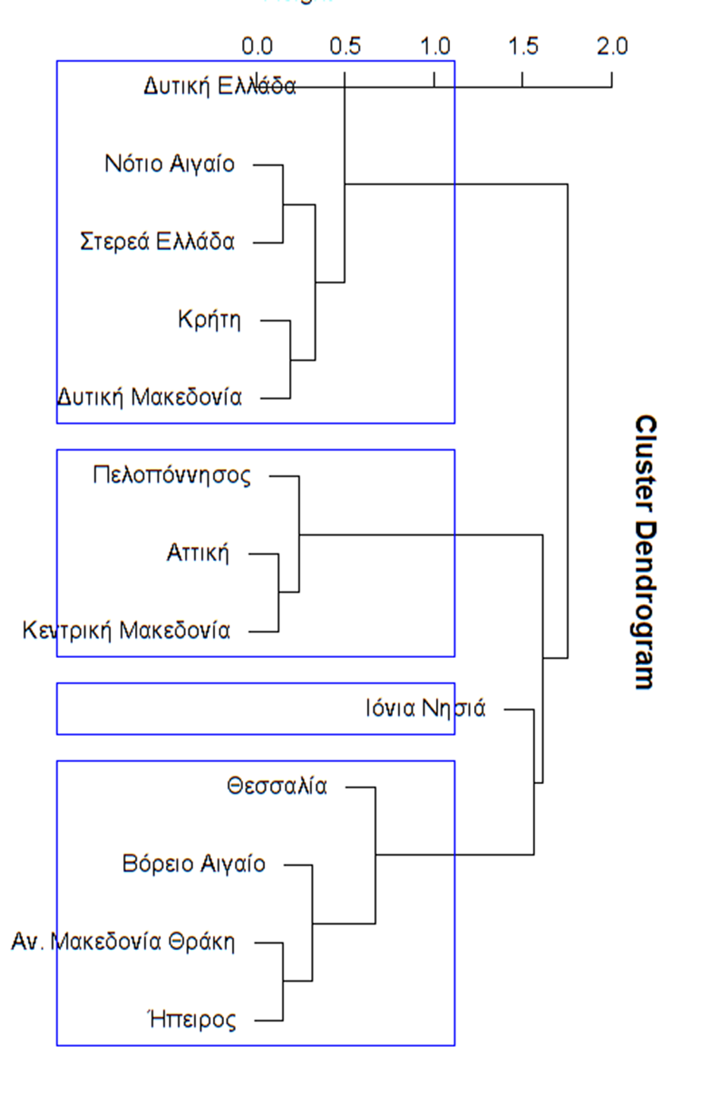
The policy mix in support of the S3s per Region
Collaborative RTDI plus
non-RTDI enterprise
support and human
resources
Research
infrastructures and
non-RTDI support to
firms
Firm RTDI &
support to modernisation

Slide 10
Key findings (Effectiveness)
1 | In all regional S3s, target-setting followed the OP output and result indicators; the results for all TOs could not be effectively attributed to S3 activities | Almost 60% of the MAs said that target setting was rather conservative in ambition
2 | The timing of the EDP (before or after the ROP approval) is not related to the performance of the ROPs in terms of supporting the S3s | The average time between the approval of the S3 and the first S3-related call was 3.5 years
3 | The expectations of front-loaded and time-flexible support to the beneficiaries were not confirmed | Implementation effectively started in 2018 The average time between the approval of the S3 and the S3-related calls was 3.5 years The average number of calls per Policy Instrument was 1.6 (median 1.33)
4 | The COVID19 pandemic was the most frequently cited exogenous factor reducing overall efficiency | Cited as factor #1 by both the MAs and the beneficiaries
5 | The lack of experience in the planning and implementation of RTDI actions by the Regions, and the limited support from the national authorities, especially in the first years of implementation of the ROPs, were the most frequently mentioned endogenous factors

Slide 11
Key findings (Efficiency)
6 | The budget earmarked by the ROPs for activities in support of the S3s was too small to generate measurable impacts | The share of the ROP funding in all RTDI-related expenditure was in the range between 1.58% (Attica) and 25.14% (North Aegean)
7 | The thematic support to S3s was limited (10.6% of public expenditure in TOs 1, 2, 3 and 8, of which 51% from TO1) | The share of public expenditure under TO 1, 2, 3 and 8 channeled to S3-related activities was in the range between 3.16% (Ionian Islands) and 36% (Epirus)
8 | Very small degree of synergies with National/European programmes | No cases of upstream/downstream funding and alternative funding A single case of complementary funding for RTDI in Western Greece
9 | A moderate share of public expenditure on 3 policy instruments could have been better utilized if target groups and/or supported activities had been more precisely defined | 36% of the investments under PI12 (digital maturity in enterprises), 27.3% under PI11 (internationalization) and 21% under PI15 (hiring young graduates) would have been implemented irrespective of the ROP support

Slide 12
Key findings (Coherence)
10 | The policy mix deployed by the national OP “Competitiveness, Entrepreneurship & Innovation 2014-2020” overlapped by 81% with the mix of PIs deployed by the ROPs | The CEI calls were launched earlier than those of the ROPs, thus claiming more mature projects The budget of the CEI calls were 10x larger than those of the ROPs
11 | The Hellenic Foundation for Research and Innovation (PI04, PI02 and PI07) and the National Development Law (PI08 and PI10) are the two principal complementary funding sources beyond ESIF in Greece
12 | Funding opportunities beyond the EU Structural and Investment Funds are relevant to a very small share of the beneficiaries | 3.3% the beneficiaries would seek a bank loan to implement their projects 2.9% of the beneficiaries would seek funding from EU Programmes to implement their projects 1.0% the beneficiaries would seek funding from other national sources to implement their projects

Slide 13
Key findings (Relevance)
13 | The ROPs did not achieve their planned support for the regional S3s | Timing and flexibility as discussed earlier The share of ROP expenditure directed to S3-related activities in the range between 3.16% (Ionian Islands) to 36% (Epirus) On the average, 44% of the planned PI were deployed 1.66 proposals per project selected for funding 18.1% of the target groups submitted a proposal
14 | There is ample room for improvement in the design of the regional S3s for the new programming period so that they can benefit from the respective ROPs

Slide 14
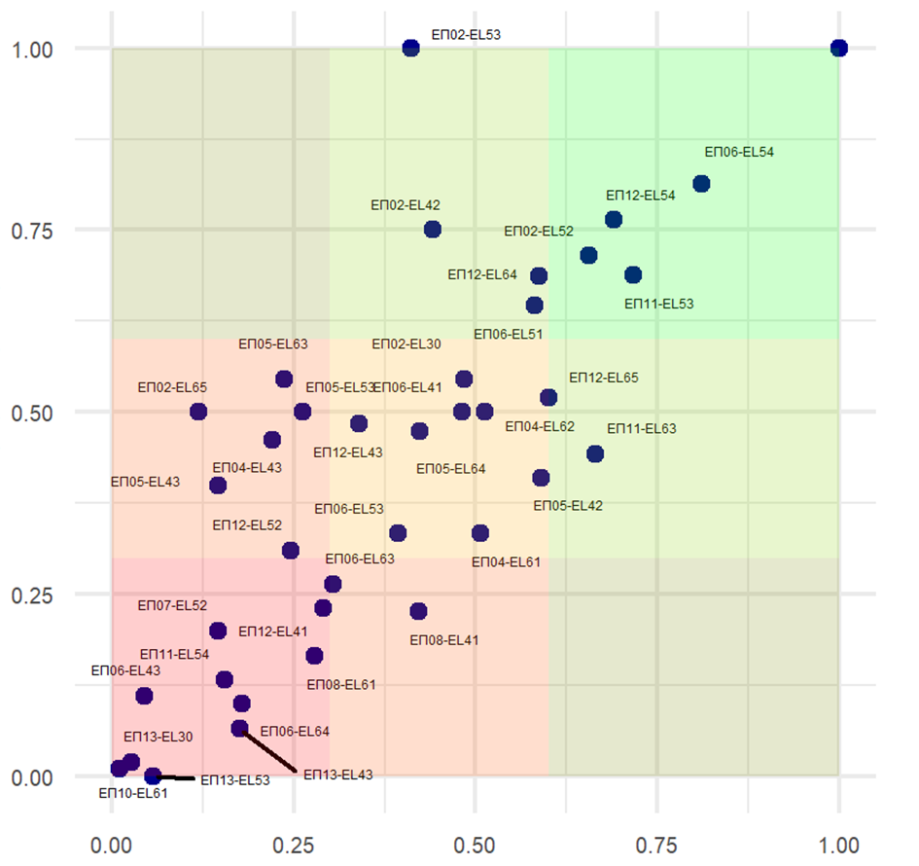
Key findings (Value added)
Degree of overlap in PIs
at the regional and the national level
15 | Few but very encouraging efforts to design and implement actions that were adapted to local needs and were not sufficiently covered by national programmes were identified
16 | There is room for improvement in the segmentation of target groups and in the project selection criteria to avoid thematic overlaps with national programmes and to support different groups of beneficiaries
Share of beneficiaries per PI
Share of expenditure per PI

Slide 15
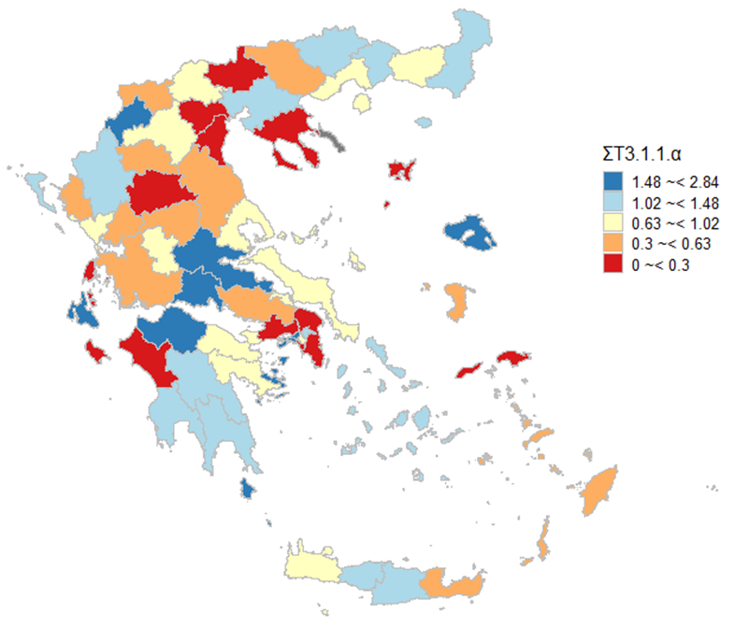
Key findings (Impact)
17 | The TOC was verified for 8 out of 13 PIs covering 83% of the public expenditure committed by the ROPs in support of the respective S3s. These PIs are on track to achieve the impacts suggested by the theory of change | The overall estimated degree of achievement of immediate results ranges, per policy instrument in the range from 63.65% (PI11) to 94.11% (PI15) The overall estimated degree of achievement of the medium-term results ranges, per policy instrument in the range from 73.77% (PI15) to 100% (PI11)
18 | The magnitude of the expected impacts, when considering the profile of beneficiaries (size, sectors) and the intensity of funding, is not expected to be significant. The impacts are expected to appear between 2024 (TO2 & 3) and 2026 (TO1)
19 | Given the policy mix, in six out of thirteen regions, the impacts are expected to be strongly localized in the capital NUTS3 territories (see inset map of the spatial distribution of S3 related investments normalised by the GVA)

Slide 16




Recommendations
Adapt the intervention logic to the specific needs of each Region; improve the selectivity of the policy instruments, and their granularity with respect to the potential beneficiaries
Adapt the policy mix to better address the needs of different territorial types so that spatial coherence is improved
Improve the coordination and the cooperation between national and regional programmes to exploit synergies and economies of scale
Improve the granularity of the S3 monitoring systems and make sure that the S3s have clear and measurable objectives, so that they can be evaluable

Slide 17







 | Dr Yannis TOLIAS
 | Innovatia Systems
 | Dodekanissou 22, GR 54626 Thessaloniki
 | +30 231 056 7442
 | tolias [at] innovatiasystems [dot] eu
Link to full text

